Slide 1
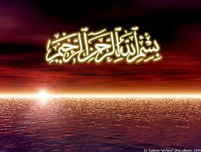

Slide 2

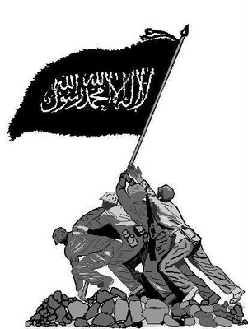
Economic System of Islam

Slide 3
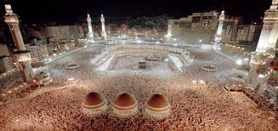
Islam is an entire way of life, and Allah's Guidance extends into all areas of our lives. Islam has given detailed regulations for our economic life, which is balanced and fair. Muslims are to recognize that wealth, earnings, and material goods are the property of God.

Slide 4

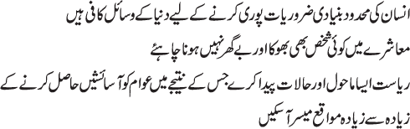

Slide 5















Slide 6
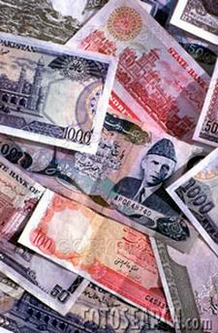
Muslims are not to deal in interest.
This ban is for all interest-based transactions, whether giving or receiving, whether dealing with Muslims or non-Muslims. It is reported that the Prophet Muhammad (peace be upon him) cursed those who pay interest, those who receive it, those who write a contract based on it, and those who witness such a contract.

Slide 7

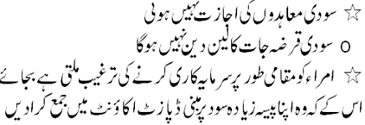


Slide 8
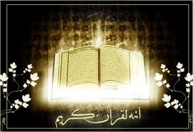
It is forbidden to gain property or wealth by fraud or other falsehoods.
"...Give just measure and weight, and do not withhold from people the things that are their due. And do not do mischief on the earth after it has been set in order. That will be best for you, if you have faith"
(Qur'an 7:85).

Slide 9

It is particularly hateful for a guardian to take from an orphan's property.
"To orphans restore their property (when they reach their age). Do not substitute your worthless things for their good ones, and do not devour their property by mixing it up with your own. For this is indeed a great sin“
(Qur'an 4:2).

Slide 10
It is unlawful to hoard food and other basic necessities.
Everyone should take what they need and no more.
"And let those who covetously withhold of the gifts which Allah has given them of His Grace, think that it is good for them. No, it will be the worse for them. Soon it will tied to their necks like a twisted collar, on the Day of Judgment. To Allah belongs the heritage of the heavens and the earth, and Allah is well-acquainted with all that you do“
(Qur'an 3:180).

Slide 11
A Muslim should be responsible in spending money.
Over-spending are strongly discouraged. "[The Servants of Allah are] Those who, when they spend, are not extravagant and not stingy, but hold a just balance between those extremes"
(Qur'an 25:67).
"O Children of Adam! Wear your beautiful apparel at every time and place of prayer. Eat and drink, but waste not by excess, for Allah loves not the wasters“
(Qur'an 7:31).

Slide 12
Muslims must pay Zakat (alms).
"And they have been commanded no more than this: to worship Allah, offering Him sincere devotion, being true in faith. To establish regular prayer, and to give zakat. And that is the religion right and straight“
(Qur'an 98:5).
Every Muslim who owns wealth, more than a certain amount to meet his or her needs, must pay a fixed rate of Zakat to those in need. Zakat is a means of narrowing the gap between the rich and the poor, and to make sure that everyone's needs are met.

Slide 13




Slide 14
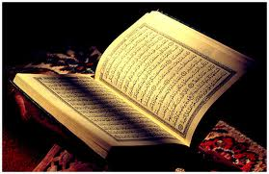
Muslims are encouraged to give constantly in charity.
"Your riches and your children may be but a trial. Whereas Allah, with Him is the highest reward. So fear Allah as much as you can, listen and obey, and spend in charity for the benefit of your own souls. And those saved from the selfishness of their own souls, they are the ones that achieve prosperity“
(Qur'an 64:15-16).

Slide 15
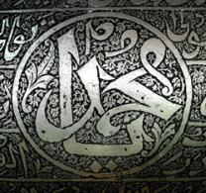
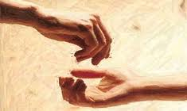
The Prophet Muhammad once said that "nobody's assets are reduced by charity."

Slide 16


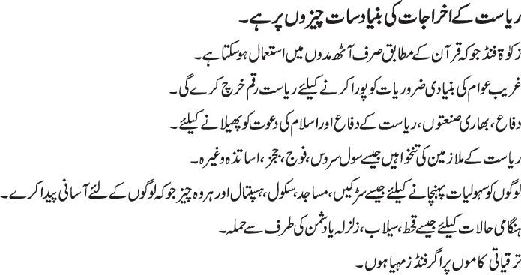

Slide 17


According to United Nation if only 225 richest peoples of the world will pay only 4% (i.e. $40.5 Arab) so, it would be enough for the rehibleation of the developing countries in regards to Water, Education, Health & food.

Slide 18



Slide 19
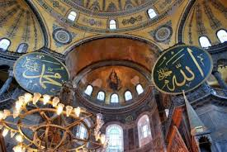
Thank You

